Slide 1
E-Courts
Convenience AND SAVINGS FOR
public AND government

Slide 2
Index
E-Courts
E-Hearings, why go to courts
E-Summons etc.
E-Services
E-Copies in courts

Slide 3
We’re being forced into the world’s largest work-from-home experiment …”
- GARTNER April 2020.

Slide 4
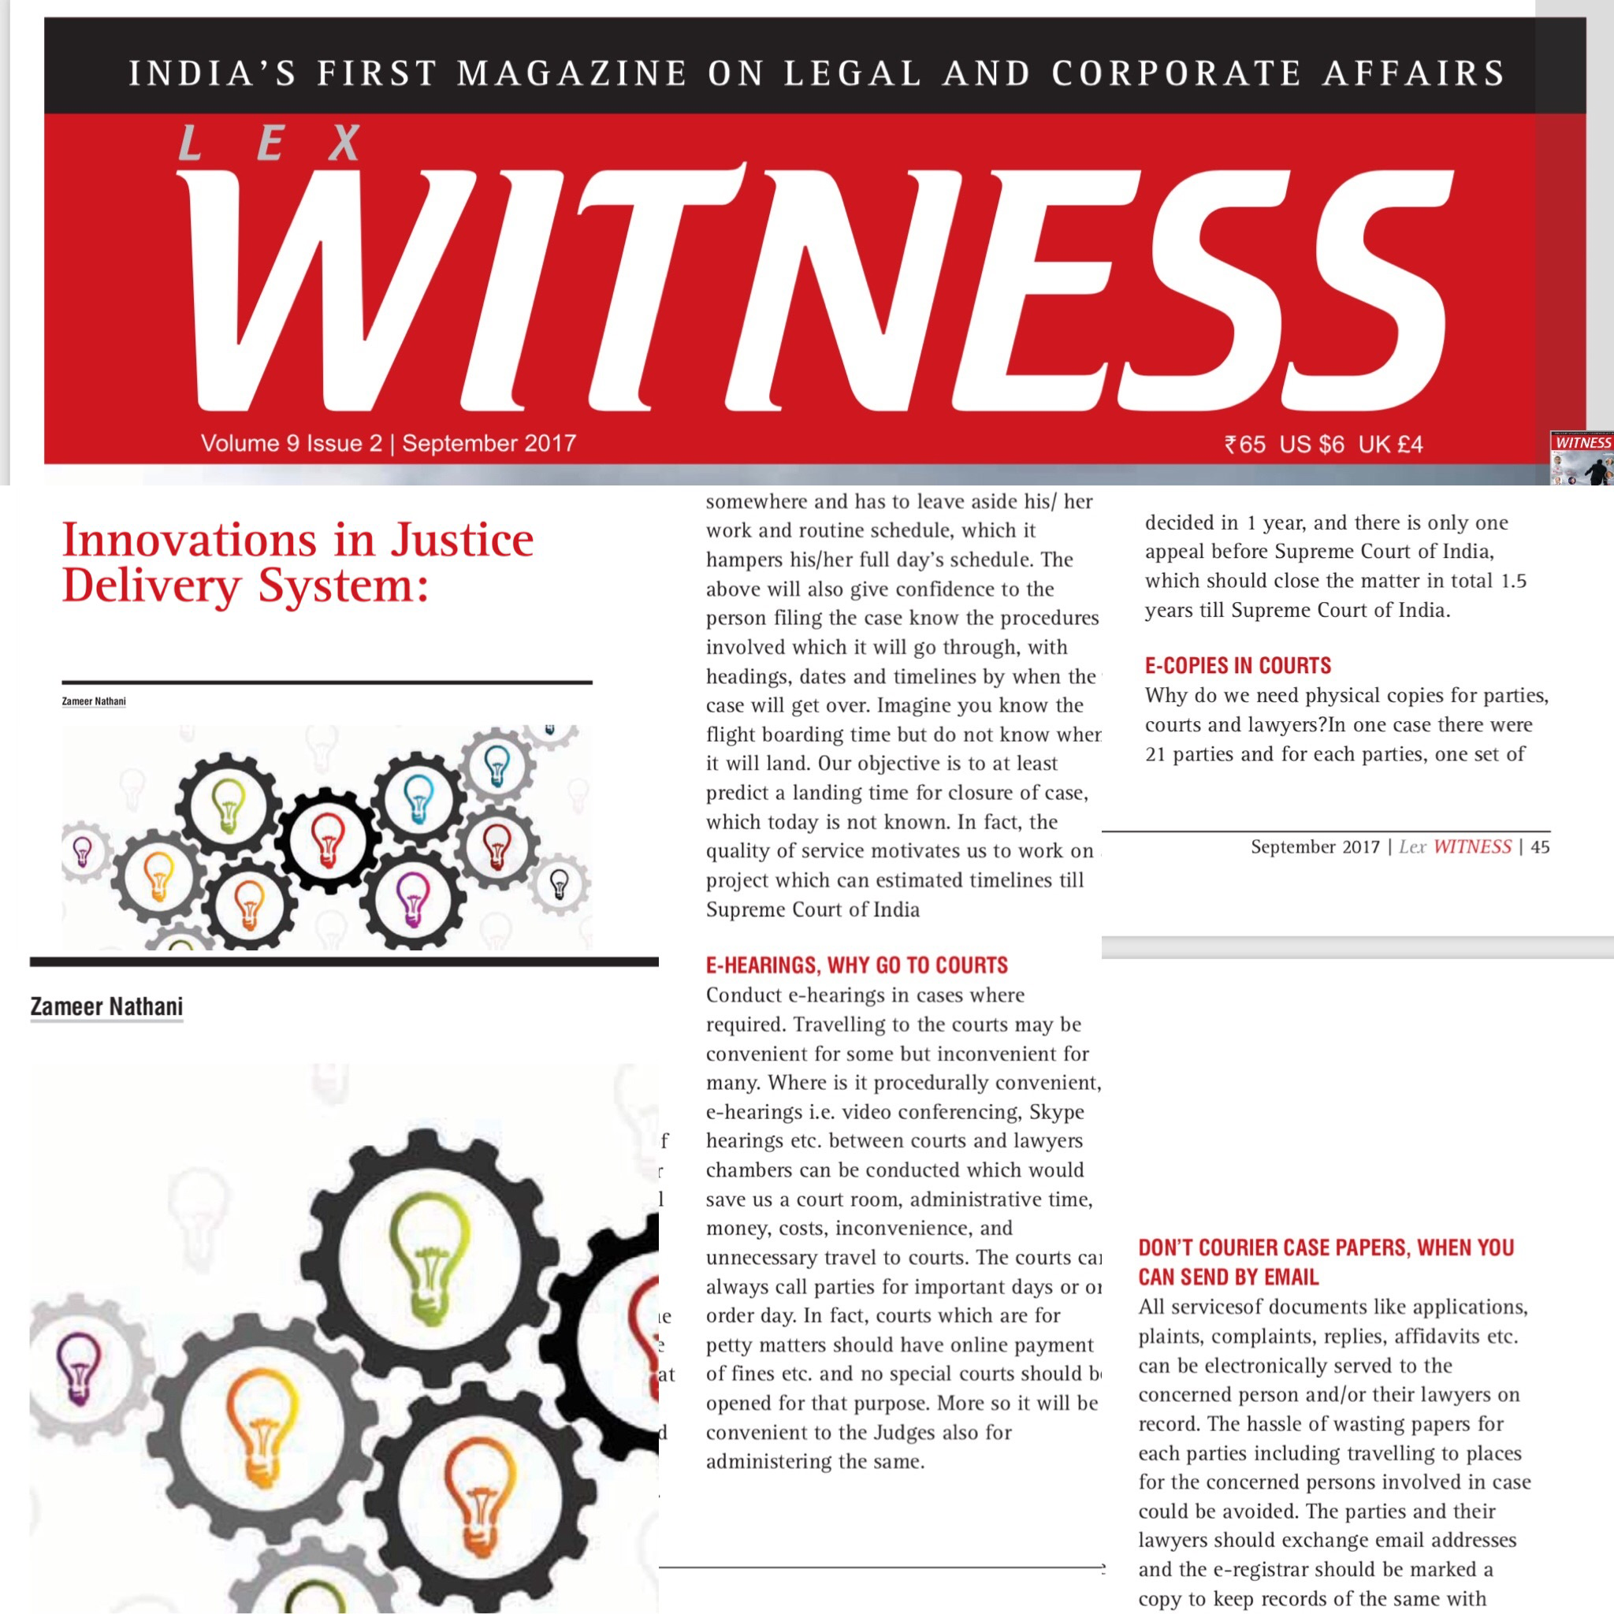
2017 Article in Lex Witness – Innovations in Justice Delivery System

Slide 5
E-Courts:
We have parties travelling from all corners of India for cases and appeals during procedural hearings and the amount of time, costs and inconvenience including loss of day work.
We can have E-Courts by using indigenous services or services of Cisco WebEx, Skype, Nokia etc. (under security cover of NIC of Government of India).
However, we will have to provide professional and compliance guidelines for all stakeholders.

Slide 6
E-Hearings, why go to courts:
Conduct e-hearings in cases where required. Travelling to the courts may be convenient for some but inconvenient for many.
Where is it procedurally convenient, e-hearings i.e. video conferencing, Skype hearings etc. between courts and lawyers' chambers can be conducted which would save us a court room, administrative time, money, costs, inconvenience, and unnecessary travel to courts.
The courts can always call parties for important days or on order day. In fact, courts which are for petty matters should have online payment of fines etc. and no special courts should be opened for that purpose.
More so it will be convenient to the Judges also for administering the same.

Slide 7
E-Summons etc.
Why do we need to serve physical summons etc., when emails can do the job.
You need the court staff to upload the same on server and email them to email ids of respective persons, lawyers etc. instead of sending it physically at costs and expenses and delays.

Slide 8
E-Services
All services of documents like applications, plaints, complaints, replies, affidavits etc. can be electronically served to the concerned person and/or their lawyers on record.
The hassle of wasting papers for each parties including travelling to places for the concerned persons involved in case could be avoided.
The parties and their lawyers should exchange email addresses and the e-registrar should be marked a copy to keep records of the same with courts.

Slide 9
E-Copies in courts:
Why do we need physical copies for parties, courts and lawyers?
In one case there were 21 parties and for each parties, one set of voluminous papers are to be given, one for court, further copies for lawyers and counsels. This literally means that “Save Trees” is only in words and not in spirits. Therefore, all parties should be given scanned copies and they can carry a device (laptop, IPad etc. in court), read and argue from that.
Secondly, maintaining physical copies in courts is so tedious, you have to keep the papers intact and secured, sometimes papers are lost or stolen etc. or not traceable, and further you need huge space to keep all papers of all matters of the court, then you have problems of white ants and for that you need to have pest control, which all can be saved in terms of space, costs etc., if we start using e-copies in courts.
Now with the advent of cloud and security we should consider creating e-records and backups as may be required.

Slide 10
Summary of E-Courts
E-Courts
E-hearings, why go to courts
E-Summons etc.
E-Services
E-Copies in courts

Slide 11
Government Owned Institutional Arbitration like court system:
Government Owned Institutional Arbitration like court but less procedures:
Like courts, we should have government owned institutional arbitration.
The advantage is that public will trust it more, costs would be economical, and it will be speedy as law of procedures are not stringently exercised in arbitration.
Secondly the Government can directly appoint arbitrators like unlike judges at collegium.
Thirdly, all commercial matters should be arbitrated before the Government’s institutional arbitration, except matters which cannot be arbitrated, which can easily reduce the courts burden by 30% or more.
The other advantage is that all arbitration matters have to be decided in 1 year with restrictive extension, and the matter can be completed in appeal before the Supreme Court of India within a period upto 1.5 years additionally.

Slide 12
Daily Time-Based Hearings:
All hearings on a day should be 20 minutes time-based hearings. You cannot keep arguing cases for hours and hours when everything is mentioned in the written submissions, case, reply or rejoinders? The lawyers cannot go on and on for hours and hours unless it is a requirement which Judges think fit in certain cases.
We kept debating on timelines for arbitration and the present government boldly decided on putting a timeline for arbitration for 1 year with restrictive extension, and, therefore, we will have to introspect in future on many processes wherein timelines may have to be considered.

Slide 13
Full Case Scheduling from Day 1 to Final Day:
There should be a full case scheduling. The moment you file a case, you should have the schedule from Day 1 to final day on the dates and duration of the case, so that one can plan accordingly.
We must remember one thing that persons coming to court generally is working or employed somewhere and has to leave aside his/ her work and routine schedule, which it hampers his/her full day’s schedule. The above will also give confidence to the person filing the case know the procedures involved which it will go through, with headings, dates and timelines by when the case will get over.
Imagine you know the flight boarding time but do not know when it will land. Our objective is to at least predict a landing time for closure of case, which today is not known. In fact, the quality of service motivates us to work on a project which can estimate timelines till Supreme Court of India.

Slide 14
“It’s one small step for man, one giant leap for mankind.”
- Neil Armstrong

Slide 15
E-courts can be a reality
THANKS
LinkedIn: zameernathani
Twitter: zameernathani
Instagram: zamnathani
FB: zameernathani

