Slide 1
Legal Industry Grappling with Covid-19
International Arbitration
Time to Explore Expansion of ODR for ADR
Dr. Kabir Duggal, New York

Slide 2
How international arbitrations are conducted BC?
Loads of paper
Loads of travel
Loads of motions
Everyone wins . . . Except the client!

Slide 3
So what has changed: Considerations of ODR
Increases access to justice
Eliminates cost-travel time
Eliminates potential geographic issues
Adapts for logistical challenges
Efficiency
Flexibility
Accessibility

Slide 4
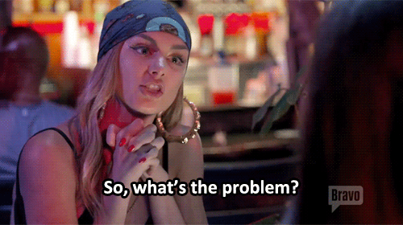
WHAT ARE THE CONCERNS?
Witness coaching
Due process
Safe and good internet connection
Familiarity with technology
Problem of zoom-bombing
Potential of hacking

Slide 5
WHAT DOES THE FUTURE LOOK LIKE?
TOO EARLY TO TELL …
INSTITUTIONS ARE DEVELOPING BEST PRACTICES
PARTIES ARE LEARNING FROM EXPERIENCE
HOPEFULLY WE EMERGE STRONGER AND BETTER

Slide 6
THANK YOU FOR LISTENING
Email: kabir.duggal@Columbia.edu
LinkedIn: https://www.linkedin.com/in/duggalkabir/

